Slide 1
Use of technology in NCDs-Issues and challenges

Slide 2
Burden of NCD
The World Health Organization (WHO) defines noncommunicable diseases (NCDs) as chronic conditions of long duration resulting from a combination of genetic, physiological, behavioral, and environmental factors.
Nearly 63% of all deaths can be attributable to NCDs, making this the leading cause of mortality in the world.
While more than 36 million people die each year due to NCDs, about 80% of NCD deaths occur in low and middle-income countries.2
India is a highly populous country with a population of more than 1.3 billion which is facing an immense burden of NCDs.
World Health Organization (WHO). Noncommunicable diseases, https://www.who.int/news-room/fact-sheets/detail/ noncommunicable-diseases (2018, accessed 8 November2019).
World Health Organization (WHO). World HealthOrganization | Deaths from NCDs. WHO, https:// www.who.int/gho/ncd/mortality_morbidity/ncd_total_ text/en/ (2015, accessed 30 July 2019).

Slide 3
Need of Telehealth in NCD
Conventional care for NCDs in a large population can be difficult because patients living with chronic conditions need continuous monitoring and prolonged treatment.
As the country suffers from a lack of adequate healthcare infrastructure and a severe scarcity of human resources for health.
Conventional healthcare delivery methods involving face-to face doctor–patient interactions might not be available to most of the people in India.
Golechha M. Healthcare agenda for the Indian government.Indian J Med Res 2015; 141: 151–153

Slide 4
Digital health & NCD
In the era of digital technologies, many mHealth and eHealth interventions have been developed to provide a wide range of healthcare services to people living with different health conditions.
Different devices and platforms, including mobile phone, website, software, wearable devices, and tablet computers, using online and offline digital technology platforms, are increasingly being used in healthcare; these are collectively termed as digital health.
The WHO recognizes the potential of digital health interventions to achieve universal health coverage and ensure high-quality care to individuals.
These interventions can provide preventive, diagnostic, therapeutic, and palliative care using digital platforms such as mobile phone, portable computing devices, internet-based applications, and social media interfaces
World Health Organization (WHO). WHO releases first guideline on digital health interventions, https://www.who.int/news-room/detail/17-04-2019-who-releases-firstguideline-on-digital-health-interventions (2019, accessed30 July 2019).

Slide 5
A systematic review by Larson et al. evaluated nine telehealth interventions for patients receiving cancer care which reported Telehealth interventions to be similarly effective as usual care in terms of improving quality of life among study participants. This study highlighted opportunities to increase access to effective telehealth services at a lower cost.(Larsen et al, 2018)
Another meta-analysis of 35 randomized controlled trials has reported beneficial effects of internet-based interventions for patients with type 2 diabetes mellitus.(Shen et al, 2018)
Digital interventions facilitate better symptom assessment, self-management, reduction of symptom distress, awareness of health conditions, patient–provider communication, timely care-seeking, follow-up and referral, treatment adherence, and improved quality of living among the patients living with NCDs.
Alwashmi M, Hawboldt J, Davis E, et al. The effect of smartphone interventions on patients with chronic obstructive pulmonary disease exacerbations: A systematic review and meta-analysis. JMIR mHealth uHealth2016; 4: e105.

Slide 7
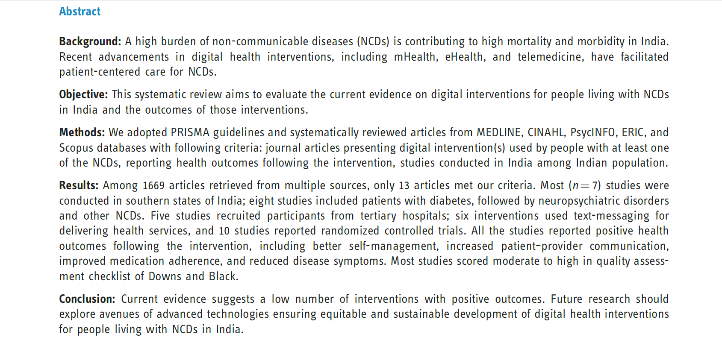

Slide 8
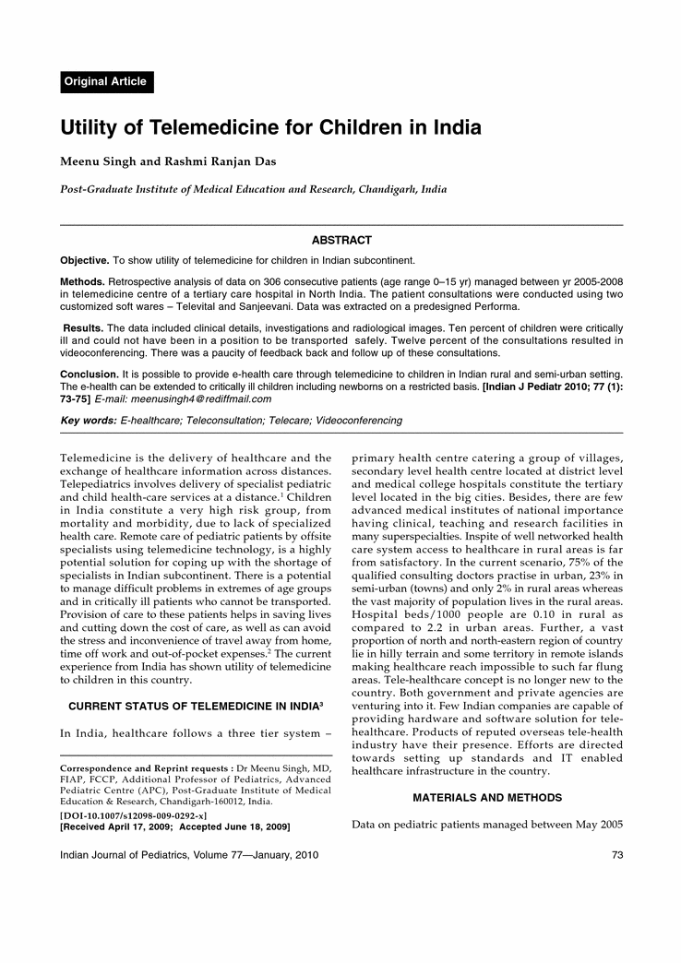

Slide 9
Opportunities
Link up all primary health care facilities using NKOFN with medical colleges and PGIMER.
Strengthen the existing facilities with improved hardware systems
Enable 108 with mhealth Tools, care delivering under telementoring
Skill development using videoconferencing
Implementation of MOOCS for Medical Students.
Implement the telemedicine services for screening of NCDs in primary health centres using HUB & spoke model under Aayushman Bharat scheme

Slide 10
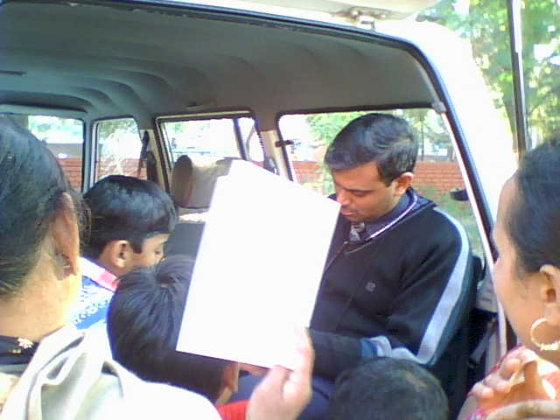
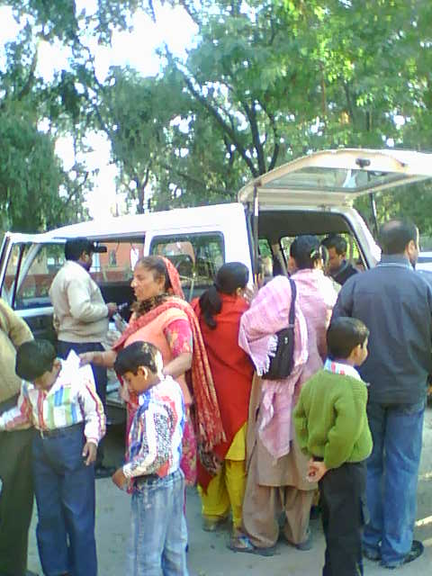
Mobile health camps

Slide 11
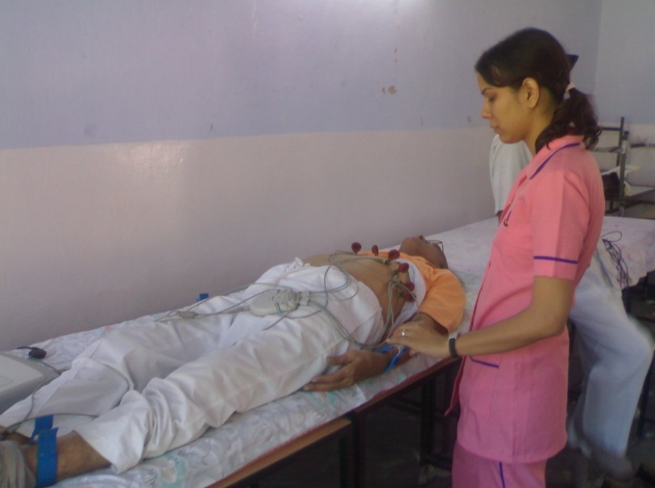
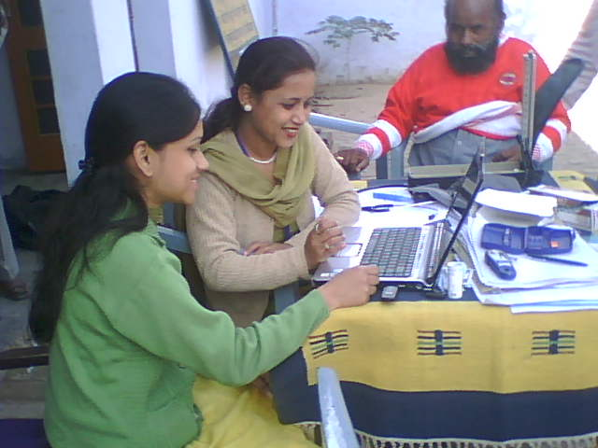
TELE MONITORING Health Camps

Slide 12
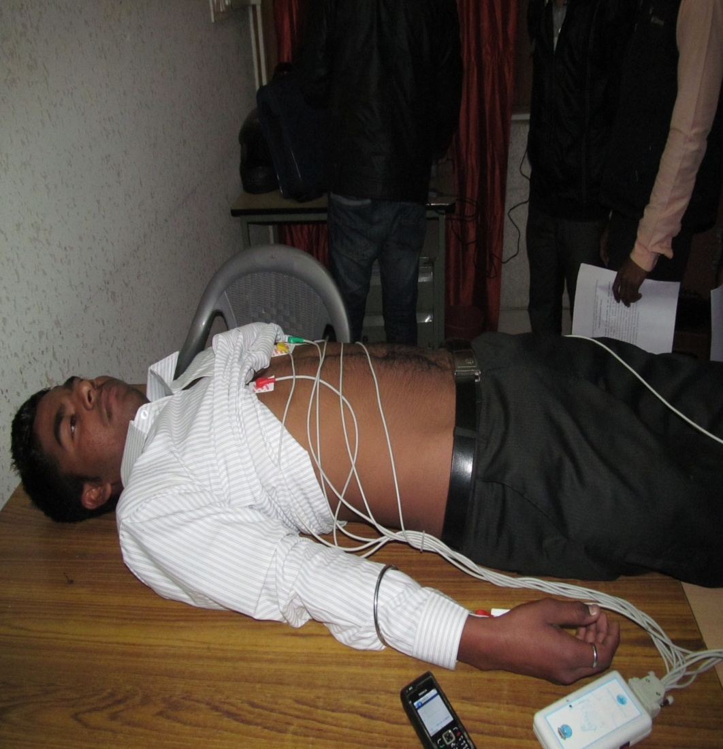
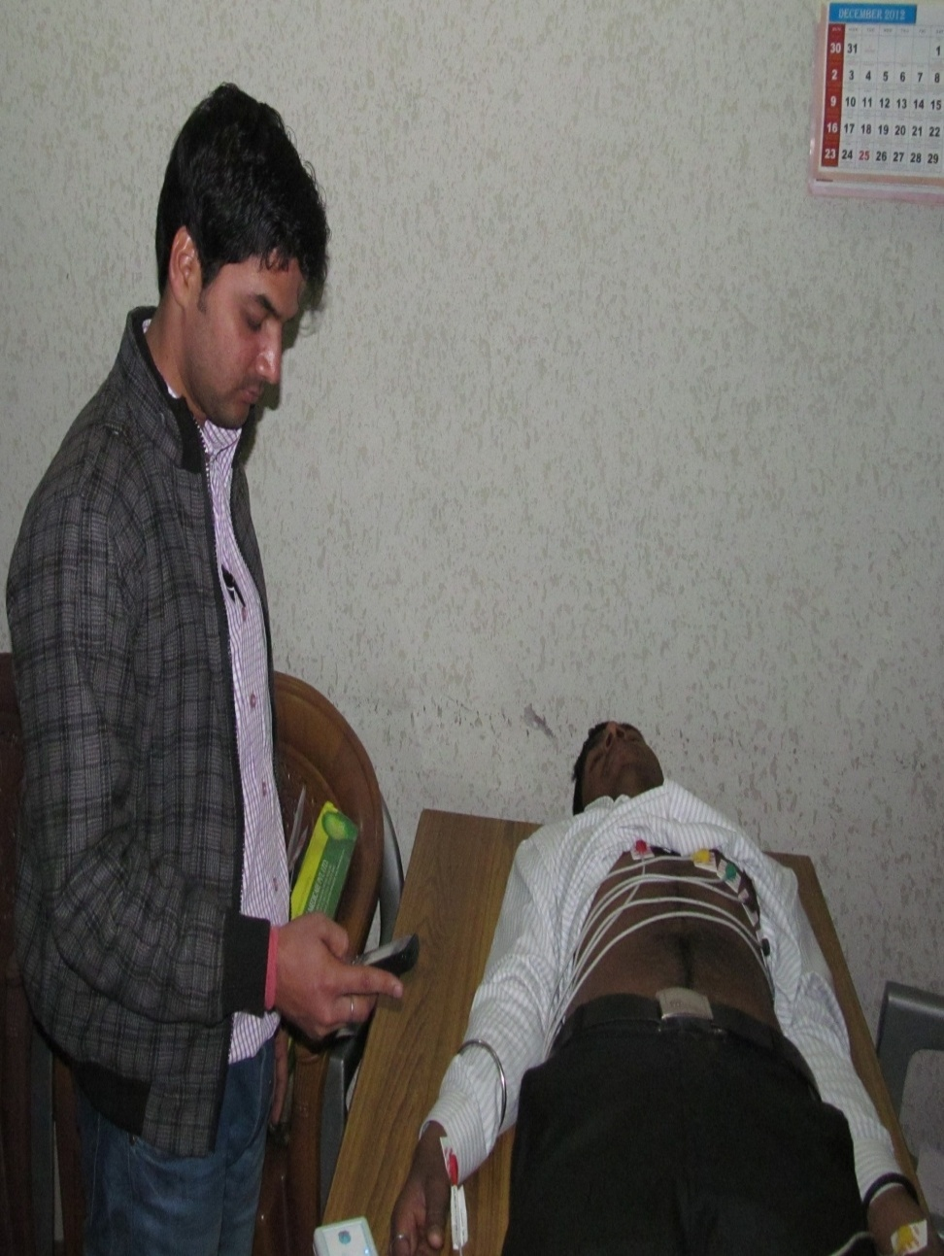
Mobile health Tools; Field testing of tele-ECG developed in collaboration with BARC

Slide 13
Spirometry in the community

Slide 14
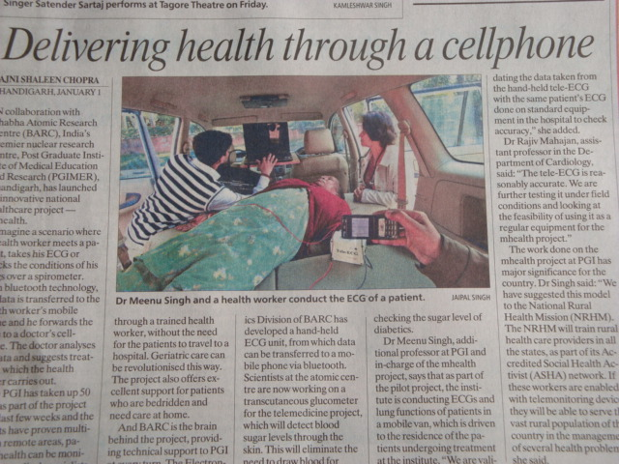

Slide 15
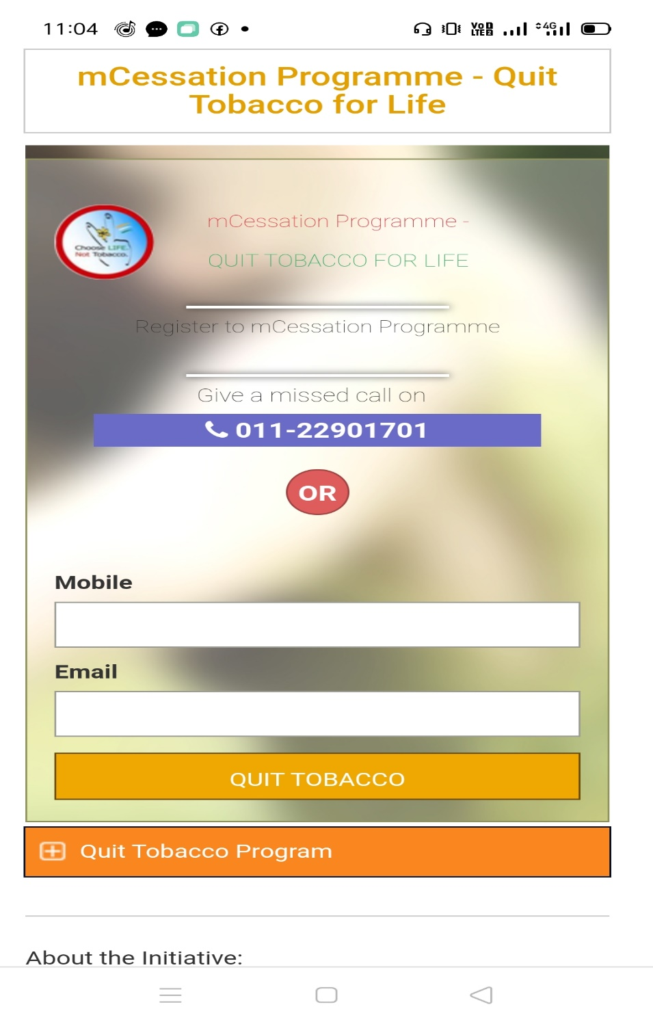
Use of technology in NCDs
Discuss one mobile based intervention related to NCDs in your state/country (Eg. Role of Quitline in tobacco cessation) Write 2 strengths
Google Fit collaborated with the World Health Organization (WHO) and the American Heart Association (AHA) to bring Heart Points, an activity goal that can help improve your health.

Slide 16
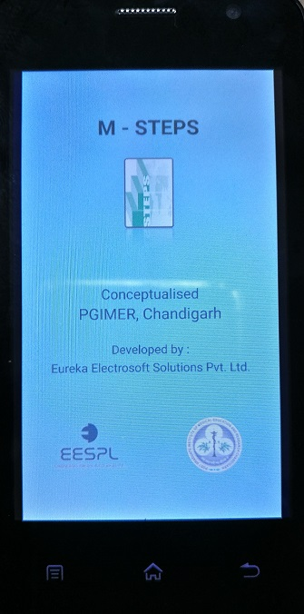
mSTEPS :Android Application for STEPS Survey
Installation in limited tablets
Edit the application
Any android based mobile/ tablet
Data collection and
entry
Import data
from mobile to cloud or PC
Data management

Slide 17
Survey Webpage

Slide 18
mSTEPS Data Management System

Slide 19
Challenges
Most of the studies on digital health interventions in India focus on the localized patient populations in respective study locations (Hossain 2019).
There are no studies which have shown a large-scale adoption of the interventions at the community, state, regional, or national level.
Sustainability and follow up of the interventions for NCD
Digital interventions would require availability and accessibility to digital devices and services such as internet and messaging
Rural population not fully educated to use mHealth devices
It cannot be assumed that the patients will continue to use the digital interventions once the study has ended

